Slide 1
Covid 19 Vaccine Registration
Steps to register and schedule an appointment

Slide 2
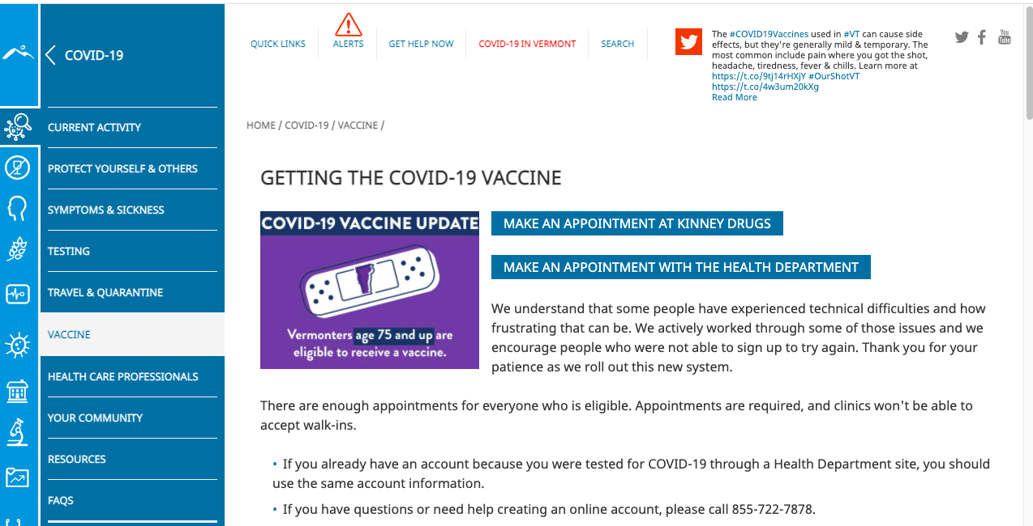
Start the registration process
Go to healthvermont.org If you have insurance, have your insurance card handy. Choose MAKE AN APPOINTMENT WITH THE HEALTH DEPARTMENT

Slide 3
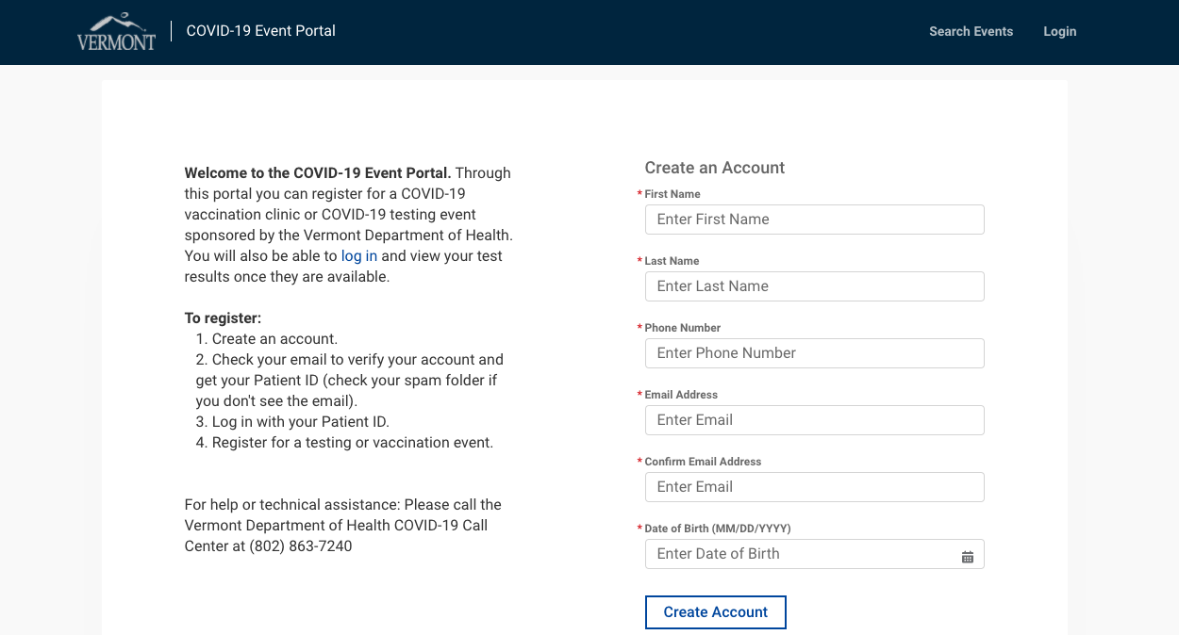
Create an Account
Double check your phone and email address. Click Create an Account. You will get an email with your patient ID

Slide 4
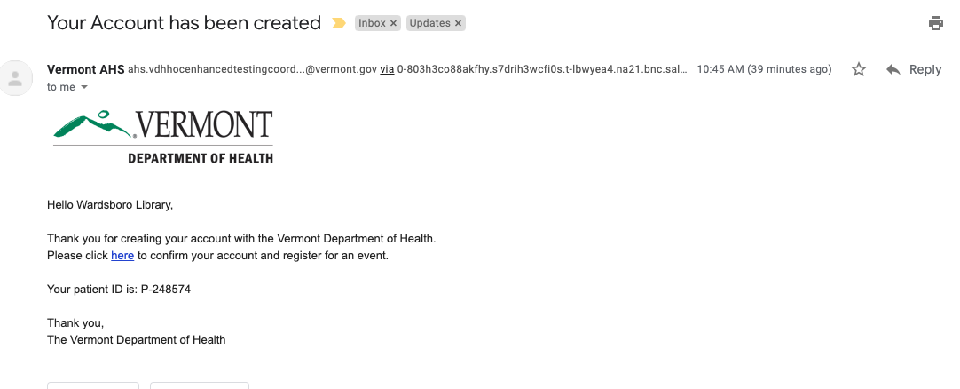
Patient ID Email
Your should receive an email-check your spam/junk folder if it doesn’t arrive
We suggest you print this so you have a paper copy of your patient ID. NOTE- the Patient ID shown here is P-248574. Click where it says Please click here

Slide 5
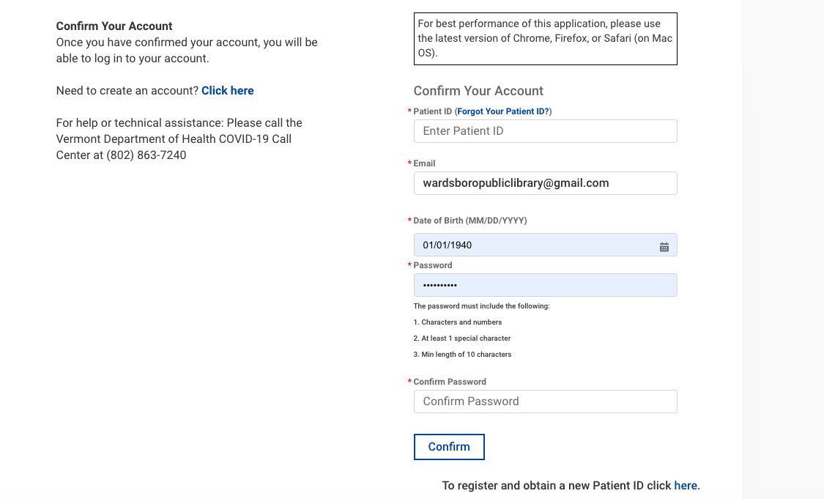
Confirm your account
Enter the Patient ID sent you, the email you registered with AND create a password – characters and number, at least 1 special character and a minimum length of 10. Once done, CONFIRM- SUGGESTION: Write the password down on the email you printed

Slide 6
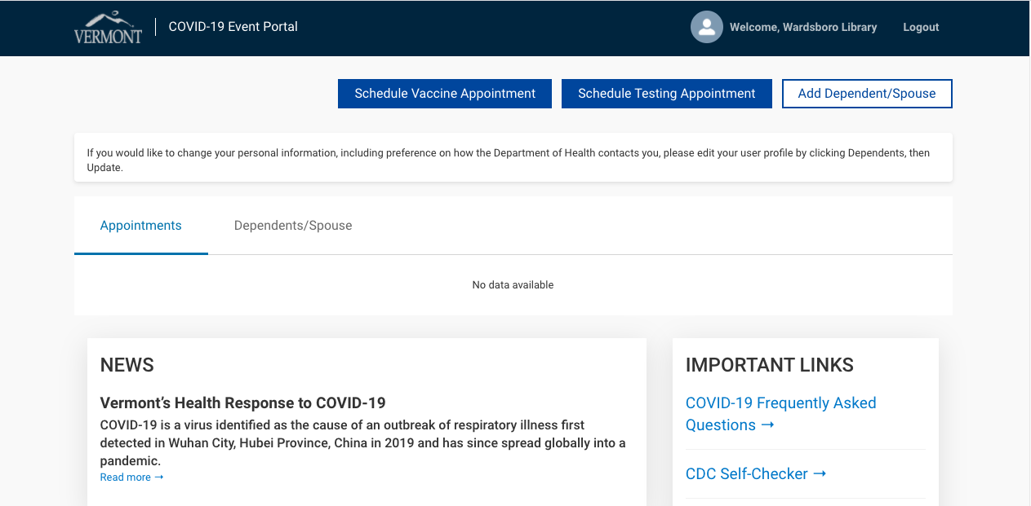
Schedule an Appointment
Click on Schedule Vaccine Appointment NOTE: You can also click on Add Dependent/Spouse so you can register more than one family member under the same email.

Slide 7
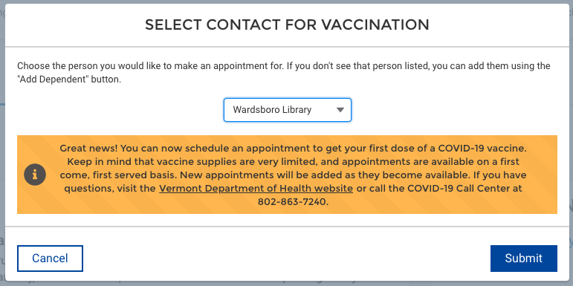
Select Contact to receive the Vaccine
Use the dropdown to choose the recipient and click Submit.

Slide 8
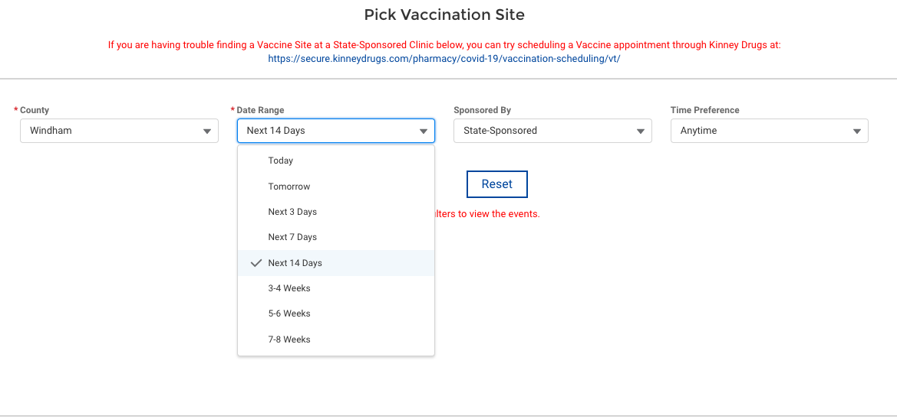
Pick Vaccination Site
Use the County dropdown boxes to choose Windham County and date range. Then click Search-

Slide 9
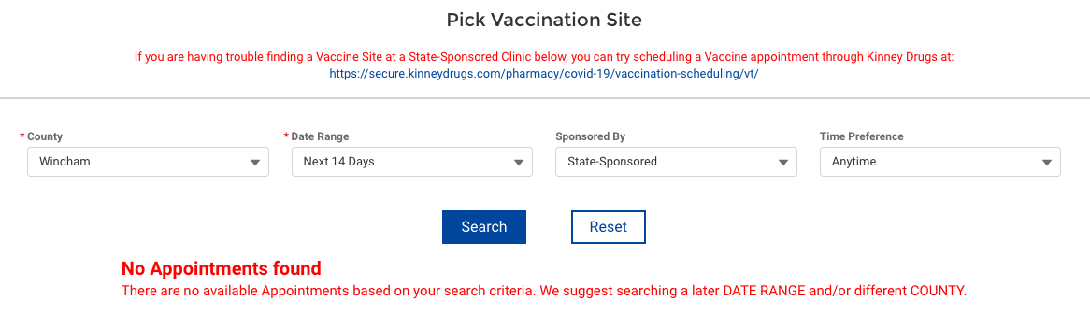
Date options
The date range requested maybe full- If so, pick a new date range

Slide 10
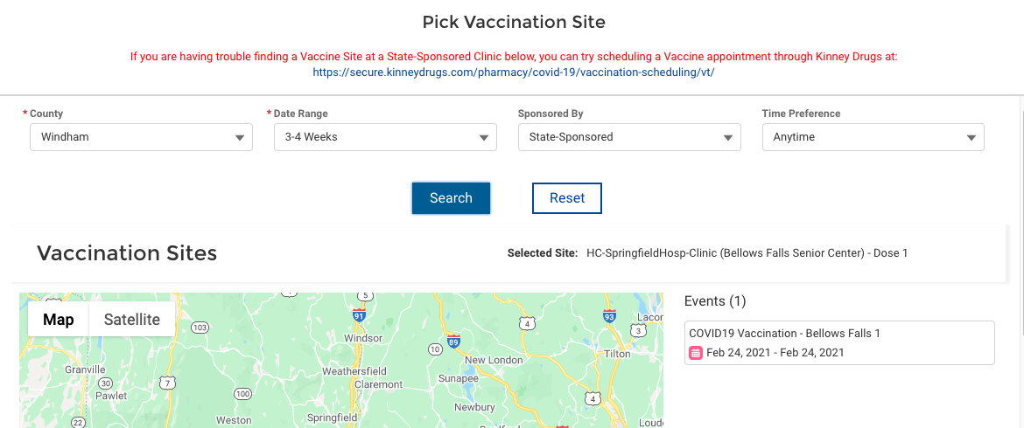
Date options
There maybe a site available in the next date range but it may not be closest to you so try a further out date range. NOTE: this is for Bellows Falls. Is that OK? If not, change date range to see other options in Windham County

Slide 11
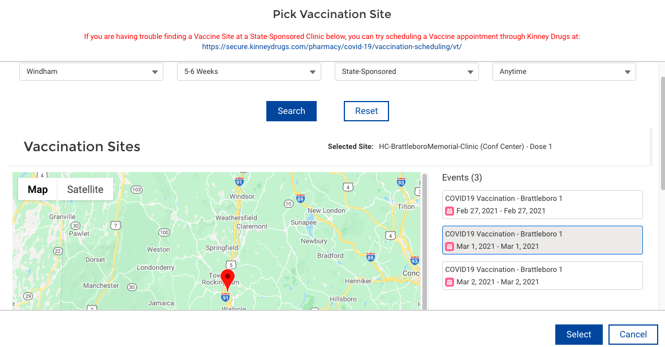
Date Options
Brattleboro is booking 5-6 weeks out. Choose a date and click Select

Slide 12
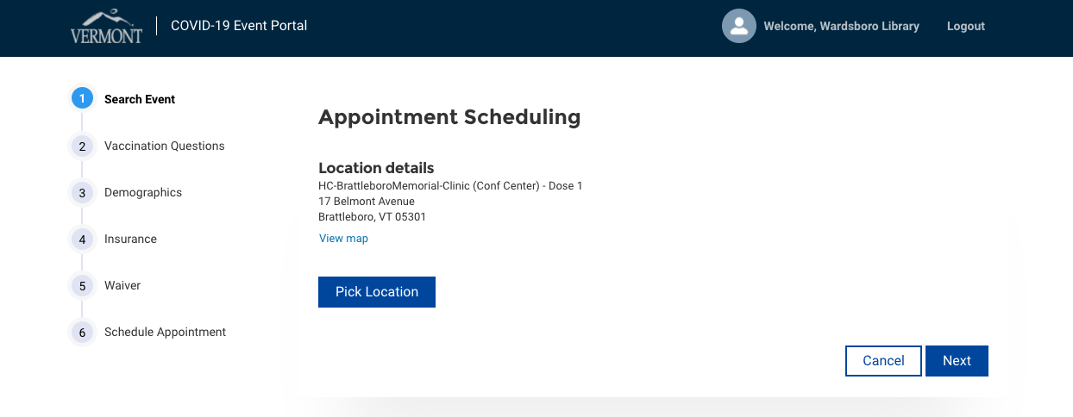
Verify Location
Verify location is what you want and click Next

Slide 13
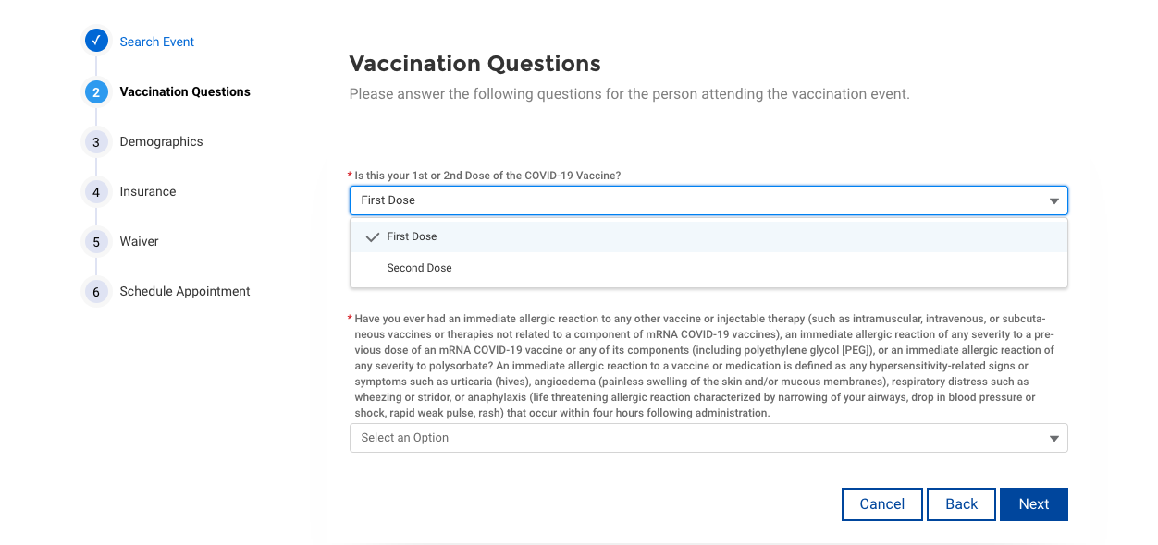
Vaccination Questions
Using dropdown, pick First Dose and click Next

Slide 14
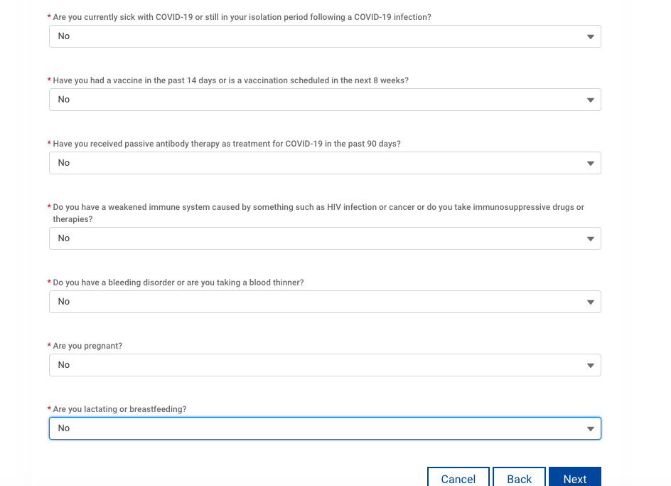
Vaccination Questions
You will be asked a series of questions about your health. Answer and Click Next

Slide 15
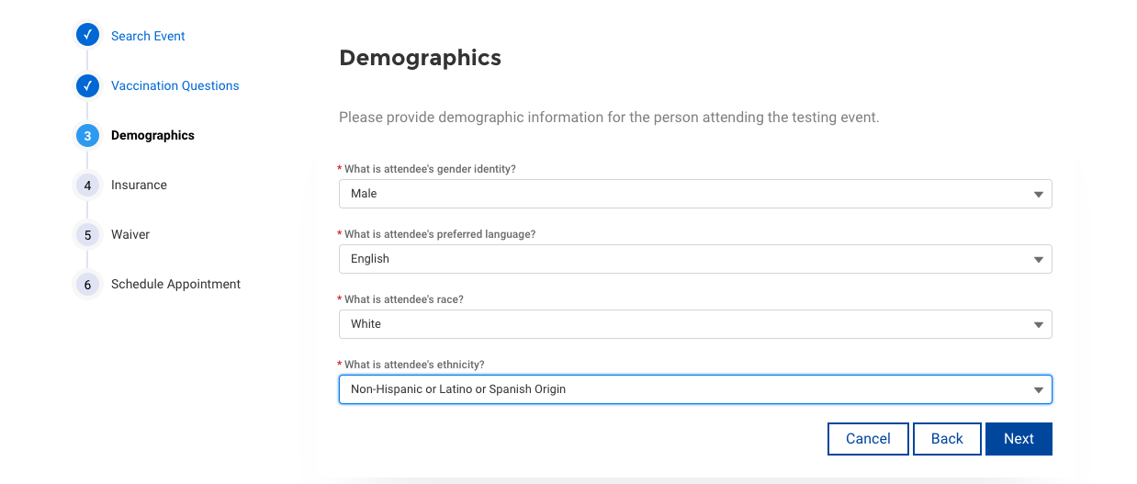
Demographic questions
You will be asked a series of demographic questions- Answer and click Next

Slide 16
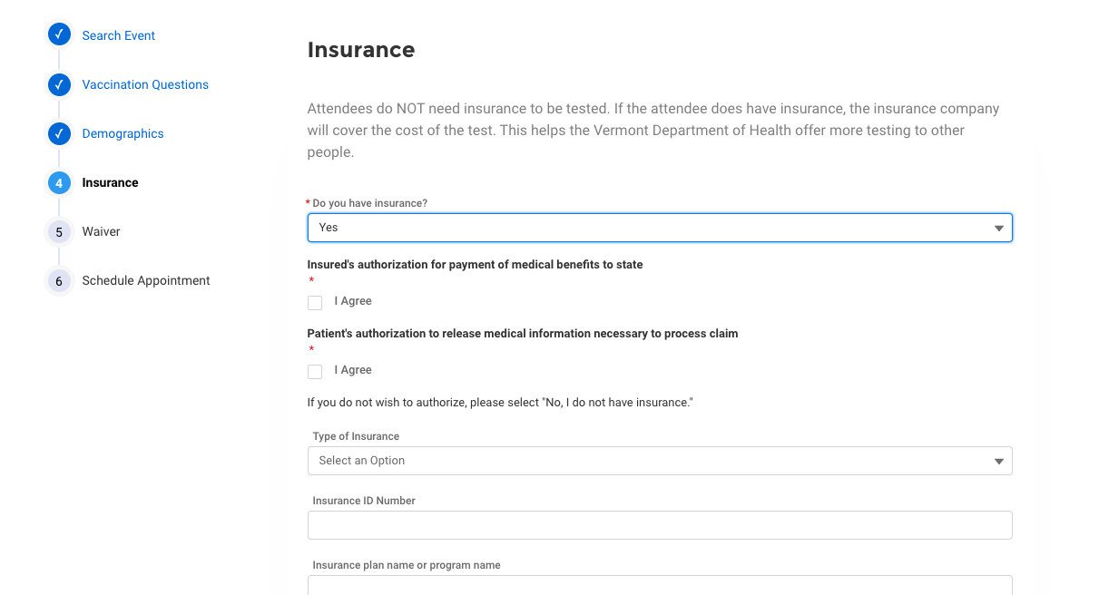
Insurance questions
If you have insurance AND are willing to authorize a release of medical information, say Yes and complete the page, otherwise say No and click Next

Slide 17
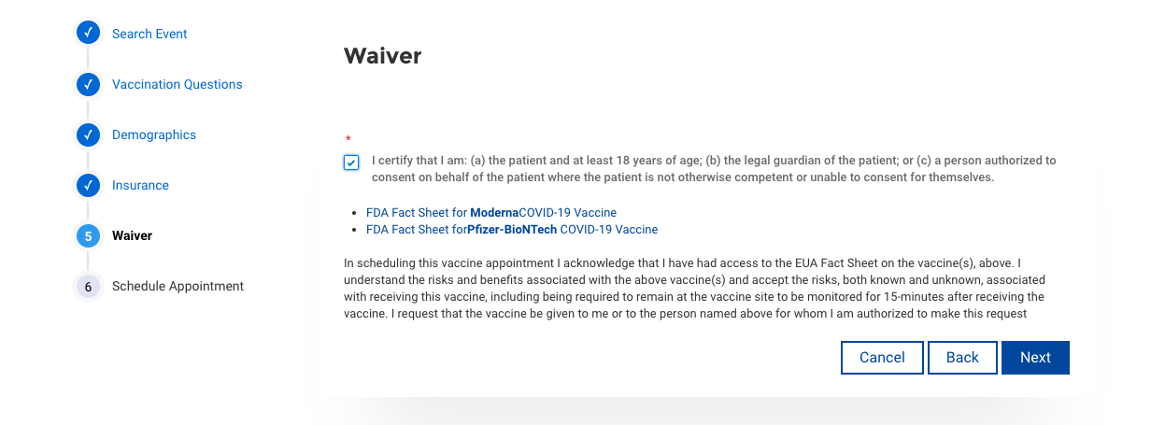
Waiver
Check the box on the left and click Next

Slide 18
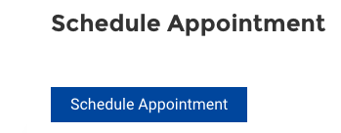
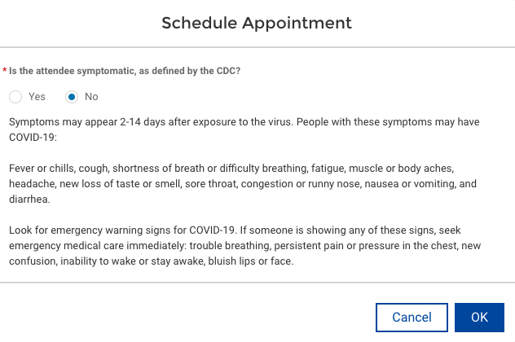
Schedule an Appointment
Click on Schedule an Appointment and a popup box will appear asking if you are symtomatic for Covid. Check No and Click OK

Slide 19
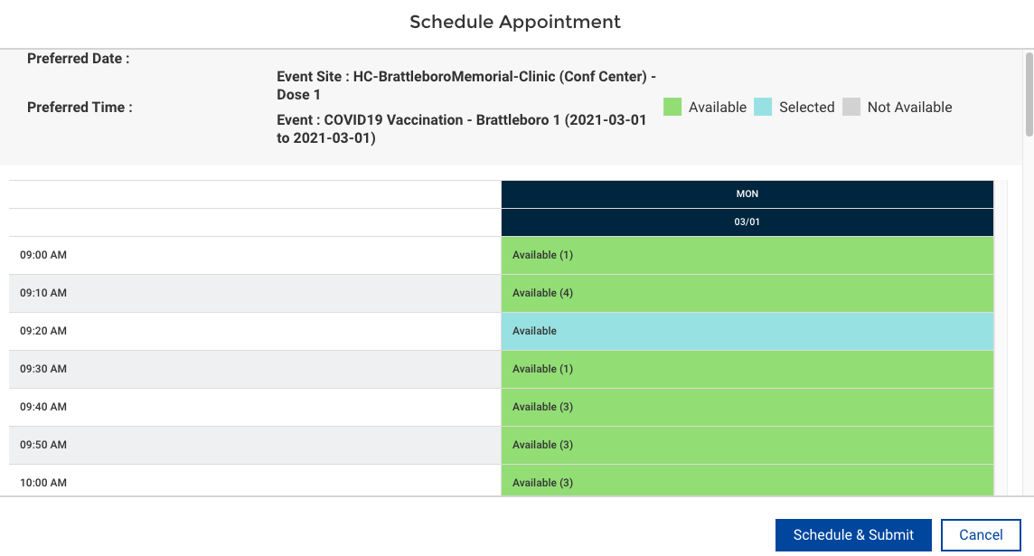
Schedule Appointment
You will be offered available times and number of slots during the day. Use the slide bar on the right to see all times. Click on desired time slot-it will change to Blue. Click Schedule and Submit

Slide 20
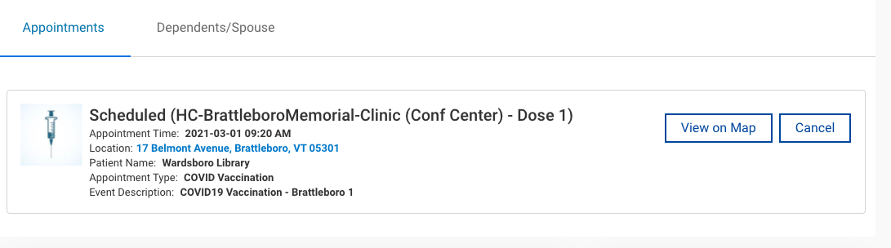
Appointment Confirmation
You will get a confirmation page AND an email sent to you. Print the email and put the appointment on your calendar. Make sure you arrange transportation for that day.

Slide 21
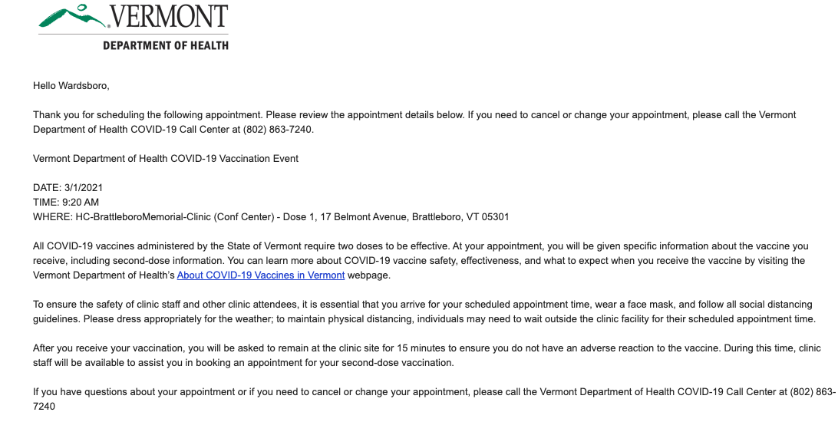
Appointment Confirmation Email
You are all set!!!

