Slide 1
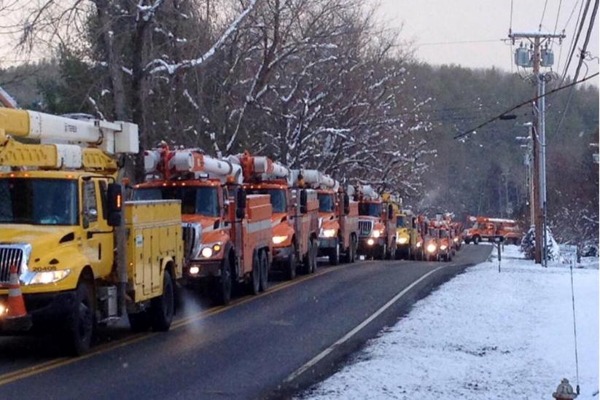
Green Mountain Power
Climate Action Planning Framework
Notes:
PSNH
Yellow & Orange – Legacy Trucks
Thanksgiving day storm mutual aid

Slide 2
Topics
Vermont Climate Trends
System Impacts from Weather
Customer Impacts from Weather
Climate Hardening Technologies and Priority Areas
The Role of Innovation
High level for local for area

Slide 3
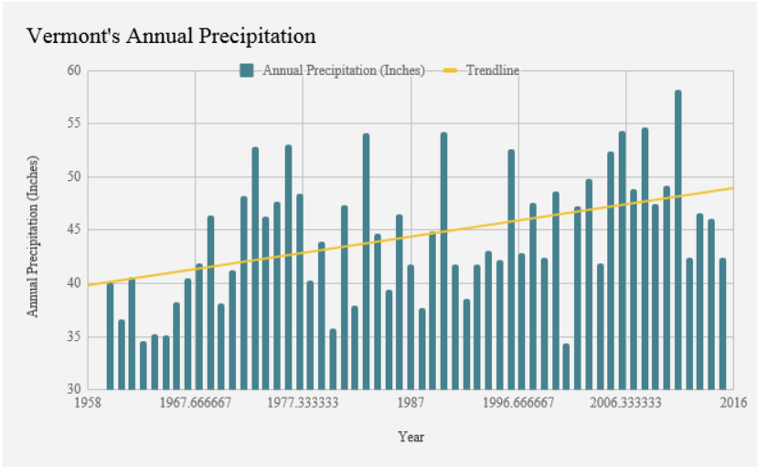
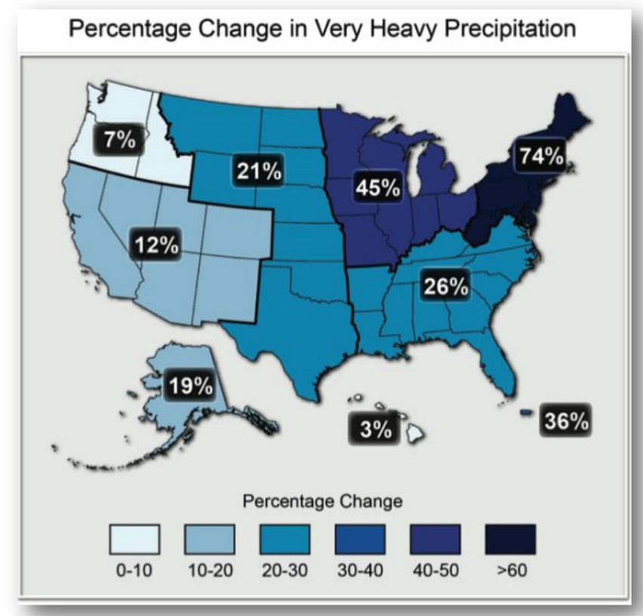
Higher Precipitation with More Intense Events
Vermont Climate Trends
Creates More Reliability Impacts
Creates More Severe Weather
More Moisture in Atmosphere

Slide 4
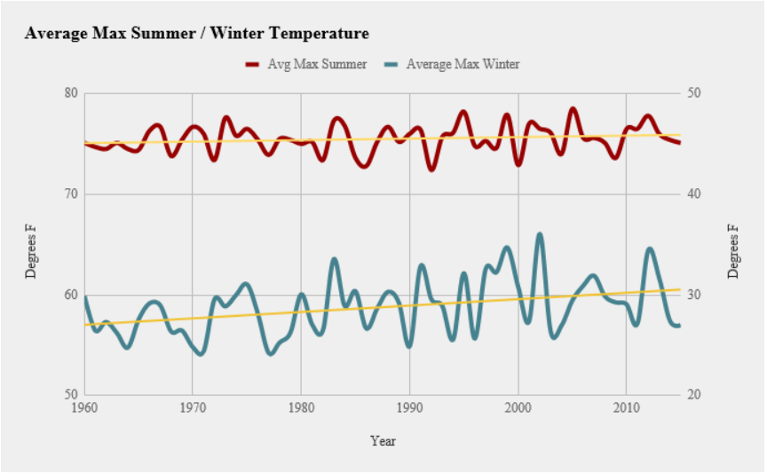
Temperatures Increasing Summer Storm Severity, Winter Wet Snow/Ice
Vermont Climate Trends
Summer
Higher Temps Fuel Severe T-Storms
Heavier, Wetter Snow/Freezing Rain
Drier, Lighter
Snow
Winter

Slide 5
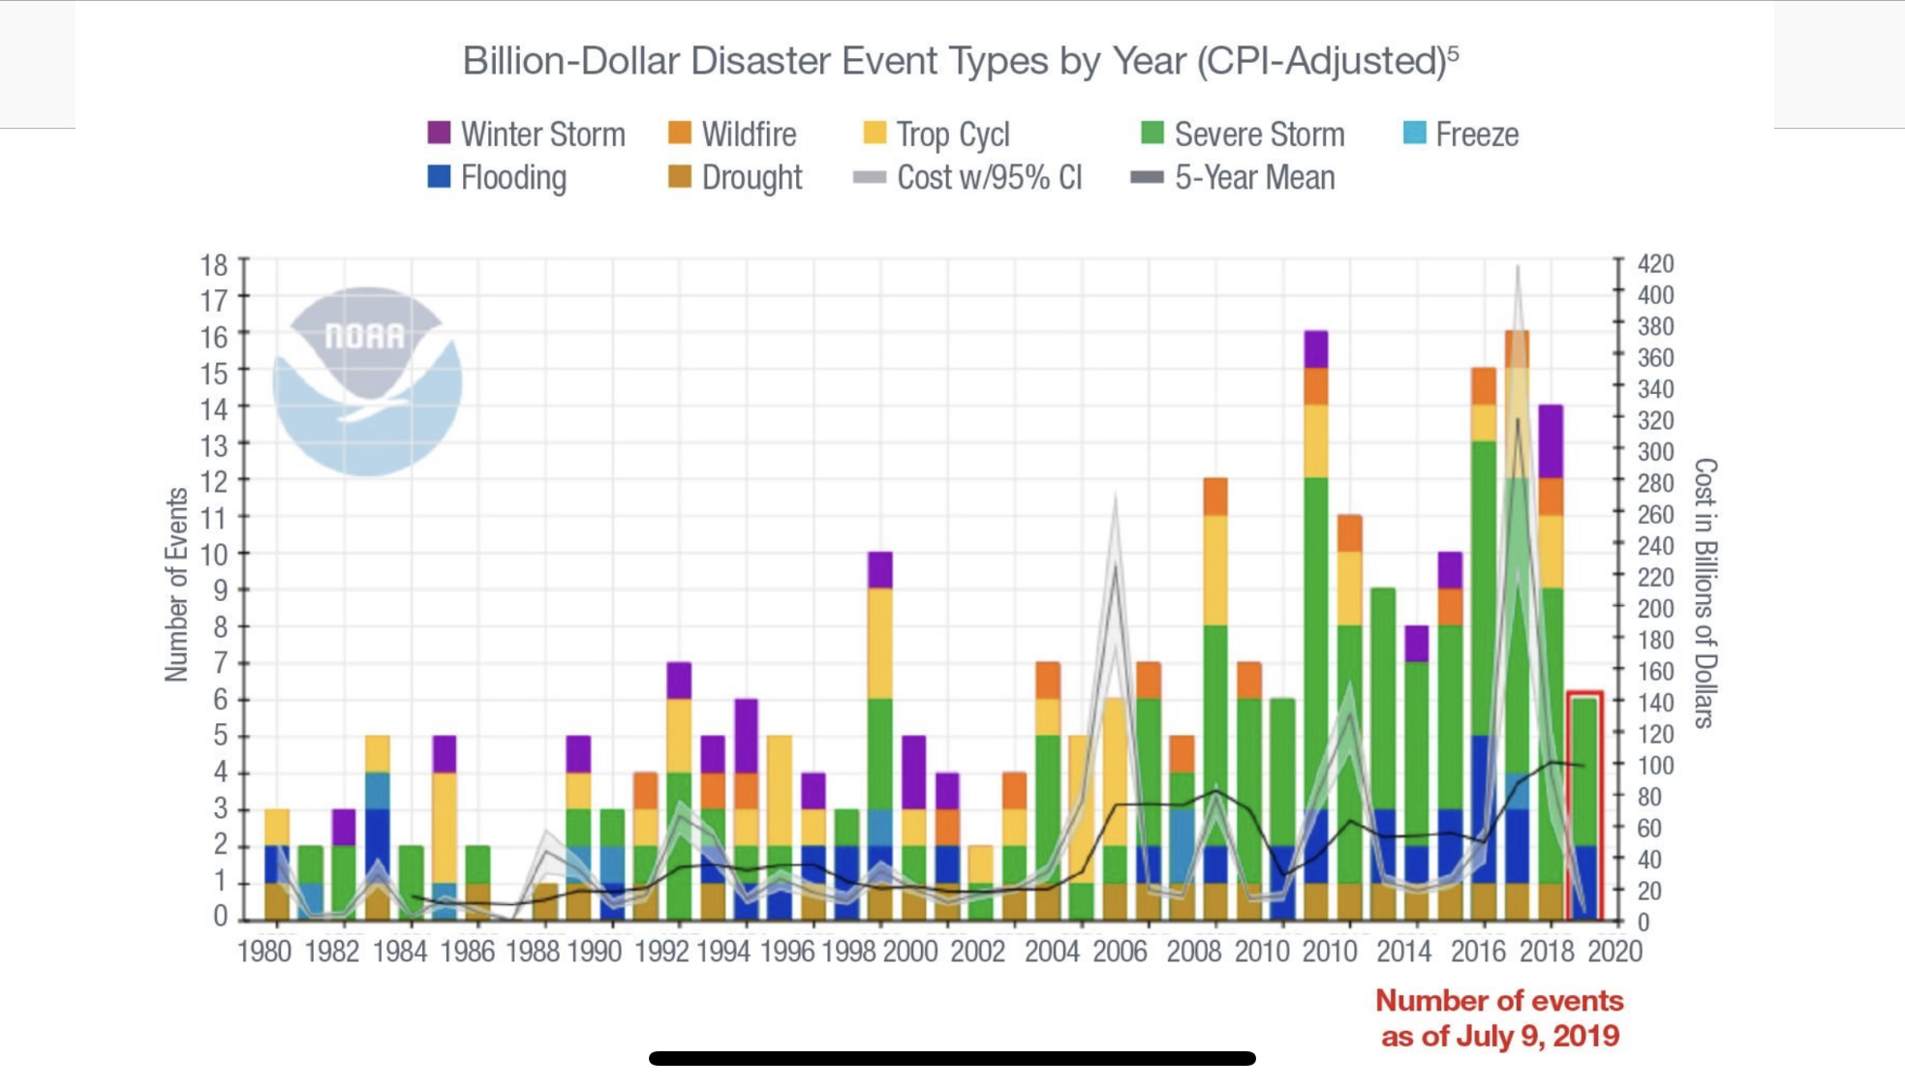
More frequent Intense storms
National Trends Impacting Vermont

Slide 6
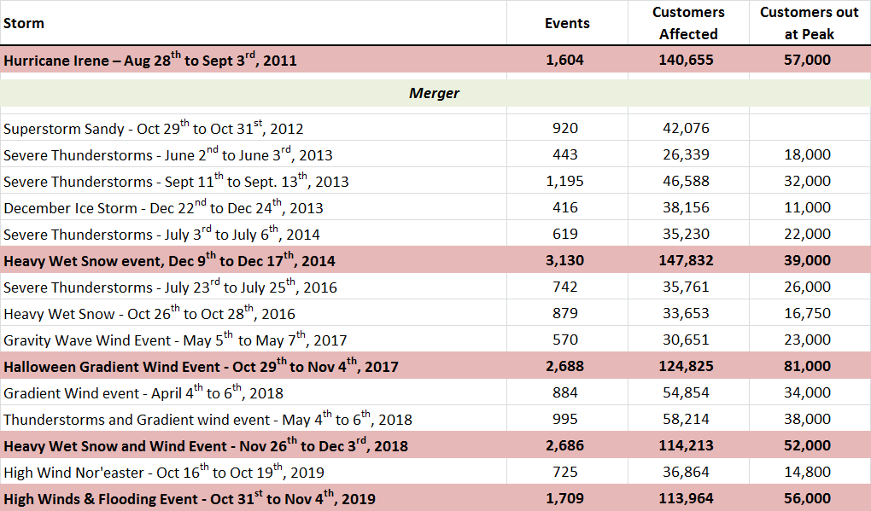
Intense Storms More Frequent
Couture Updating this
Vermont Experience

Slide 7
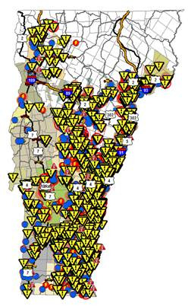
GMP Outage Map
Halloween 2019
55,000 out at peak
Storm total: 114,000
2,167 “Outage Events”
Hundreds of “Hazards”
3.75 day restoration
Damage particularly in Connecticut River Valley

Slide 8
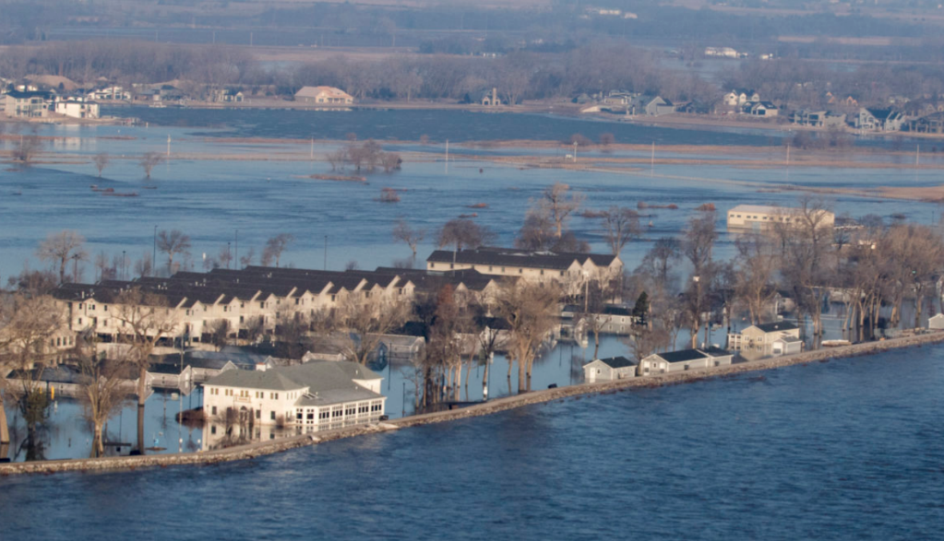


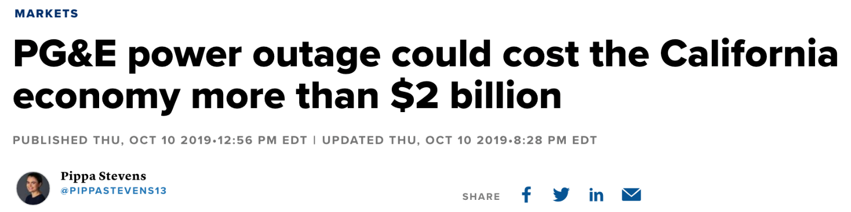
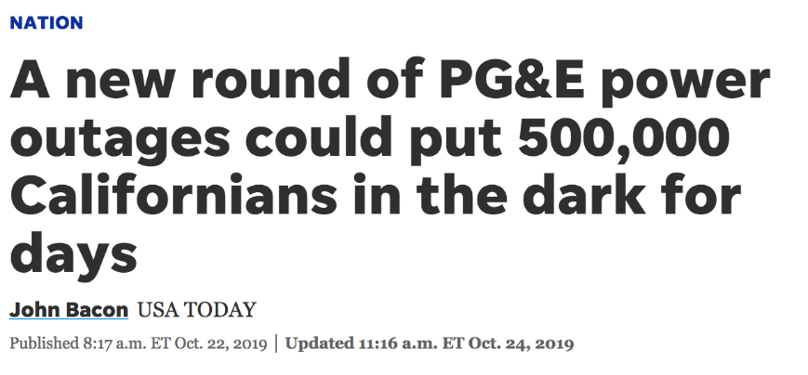
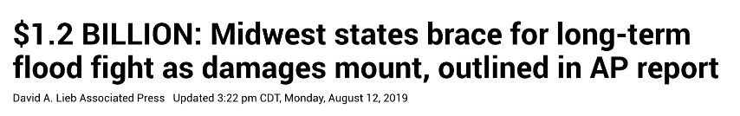
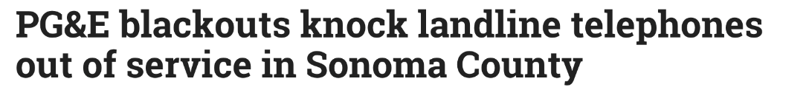
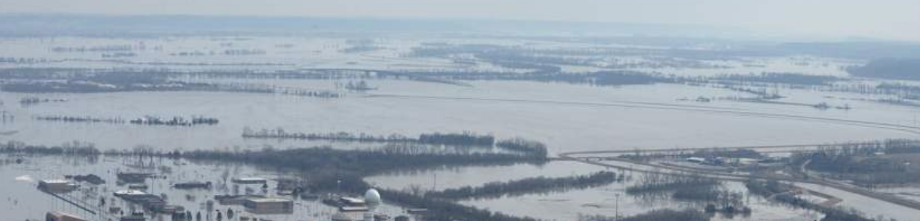


GMP Goal
Climate Action Plan
Serve customers by avoiding impacts of severe disruption and damage experienced elsewhere in country

Slide 9
Priority Areas
Climate Action Plan
Planning Category | Highlights
T+D | Prioritized and intensified Circuit Hardening; Utilize resilient construction techniques
Substations | Accelerate floodplain analysis & relocations
Generation | Prioritize high water event management; catastrophic event emergency operating protocols, in addition to planned upgrades
IT/OT/Telecomm | Ensure cloud-based redundancy of critical systems; establish power and telecomm redundancy for critical systems
Stakeholder Communications | Improve ability to generate targeted communications (customer and non-customer) via text, email, and robo-calls during events
Resiliency Zones | Plan with state and communities to support critical areas of Vermont for grid islanding during widespread, extended disaster events
Innovation | Continue expansion of storage to customers for safety and reliability through GMP & BYOD programs

Slide 10
Prioritized Communities/
MOST DIFFICULT Reliability
Circuits
Climate Hardening T&D
Lowest Reliability Ran | Circuit | Communities Served | Customer on Circuit
1 | Sharon (SH-G35) | Sharon, Strafford | 1,331
2 | East Barnard (EB-Y38) | Pomfret, Barnard | 233
3 | Londonderry (LO-G26 | Windham, Londonderry | 962
4 | East Jamaica (EJ-G7) | Townshend, Jamaica | 2,607
5 | Mount Holly (MH-G13) | Mount Holly, Shrewsbury | 1,791
6 | Rochester (RO-G62) | Rochester | 1,307
7 | Rawsonville (RA-G23) | S. Londonderry | 583
8 | Sherburne (SB-G91) | Plymouth, Killington | 1,174
9 | Pleasant Street (PS-G43) | Randolph, Braintree | 1,982
10 | Woodstock (WK-G81) | Barnard | 1,263
11 | Londonderry (LO-G27) | Londonderry, Weston | 1,844
12 | Cavendish (CV-G65) | Cavendish | 313
13 | Silver Lake (SL-W1) | Leicester, Salisbury | 292
14 | Stockbridge (ST-G45) | Stockbridge, Pittsfield | 1,026
15 | Hewitt Road (HR-G38) | Bristol, Lincoln | 2,495
16 | Randolph Center (RC-G51) | Randolph, Brookfield | 861
17 | Carvers Falls Sub (CF-G16) | Benson | 708
18 | Woodstock (WK-G82) | Woodstock | 1,008
19 | Rawsonville (GA-G22) | Jamaica, Winhall | 931
20 | Wallingford (WF-G23) | Danby, Wallingford | 2,343
Red areas are reliability challenged areas we’re going after!! We’re already concentrating on these areas, but want to move faster.
* Five Year Annual Ranking Average (2014-18)

Slide 11
Western Windham and Eastern Bennington Specific
Climate Hardening T&D
  Rebuild of main lines that have historically had reliability issues
  After main lines are rebuilt, move out to smaller tap lines
  Already designing rebuilds of the toughest reliability areas in, Dover, Halifax, Marlboro, Readsboro, Stamford, Whitingham.
  Purchased the Jacksonville Hendrix feed to re-feed portions of Whitingham and Halifax. Rebuilt and took ownership of old National Grid line this past summer that feeds Readsboro.
  Many other rural feeds in Dover, Marlboro, Readsboro already done!!
* Five Year Annual Ranking Average (2014-18)

Slide 12
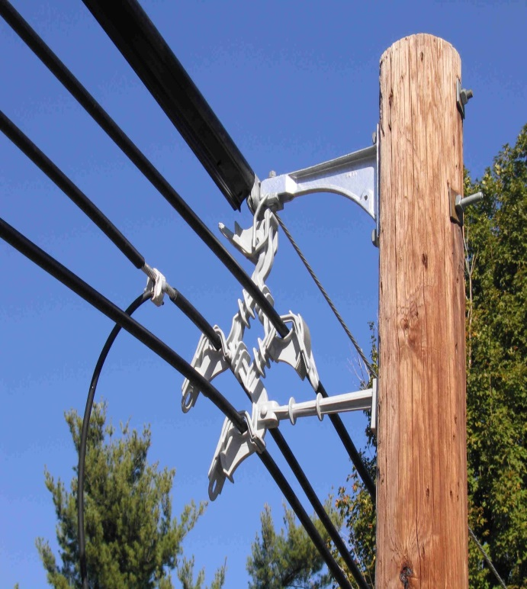
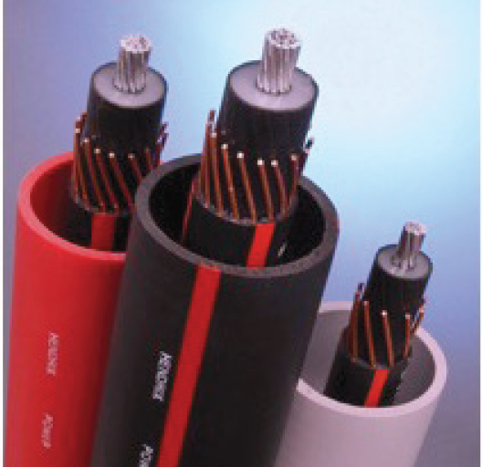
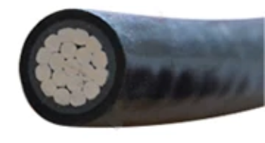
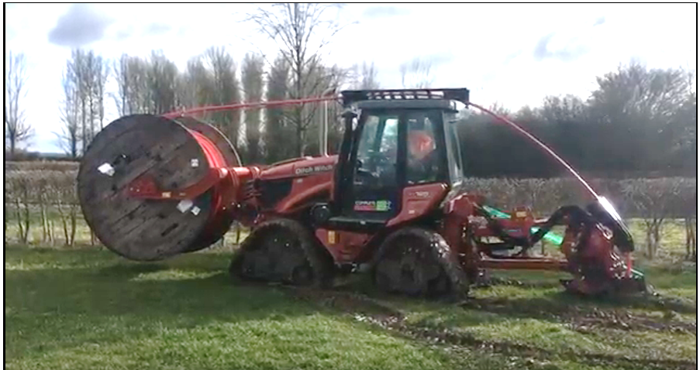
Climate Hardening T&D
Cable in Conduit Undergrounding
  Cost-Effective, Single-Phase Distribution Undergrounding
  Drastically reduces all weather related outages
Covered Wire
  Spacer Cable Construction and Insulated Tree Wire
  Much more resilient to tree contacts

Slide 13
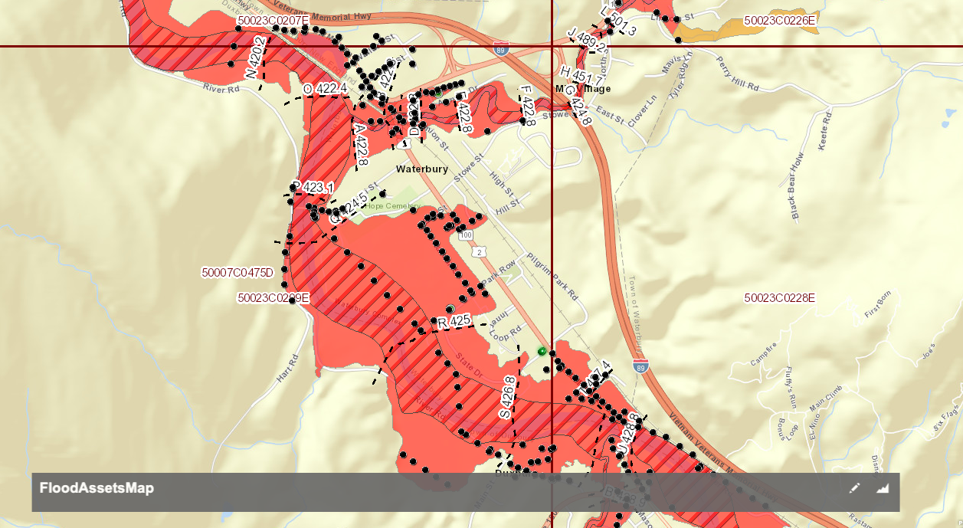
Substations and T&D Assets 100 Year
Flood Impact Models
Climate Hardening

Slide 14
Substation/infrastructure relocation
Climate Hardening
Rebuild priority flood area substations and related infrastructure to aid community resiliency and lessen damage
Dover Sub in located in a flood plain, would be one of the subs we would work to relocate. Only other sub in this immediate with a flood threat is Vernon.

Slide 15
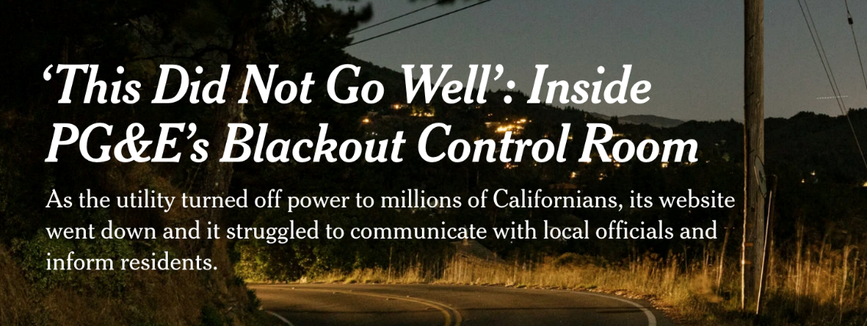


IT/Telecom/Outreach
KC Words
Insert pic of Jocelyn
Climate Hardening IT
Goal: Further improve GMP’s communications systems and related IT for disaster response and outage management.
Increase targeted customer and stakeholder outreach capability – seamless, real time, and segmented.
Improve resilience of critical GMP IT infrastructure through Cloud.

Slide 16
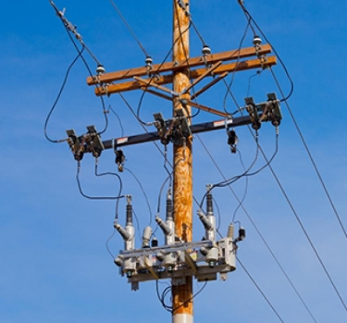
Fault Detection, Locating & Isolation
Climate Hardening IT - Self-Healing Automation
Automated Fault detection, locating and isolation.
Reduces extended outages to only those customers nearest the fault.
The Automatic Switch on the Grid:
Viper Re-Closer Protection/
Detection Device

Slide 17
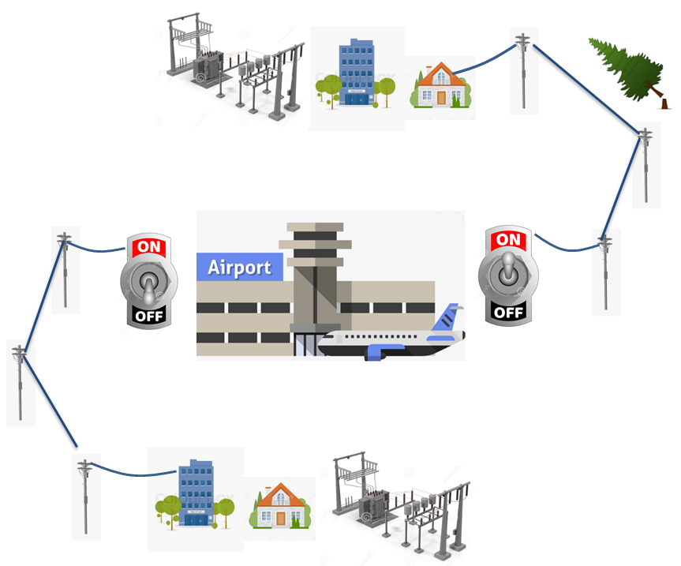
How It Works
Self-Healing Automation
Allows critical facilities to switch to alternative feeds when outage occurs.

Slide 18
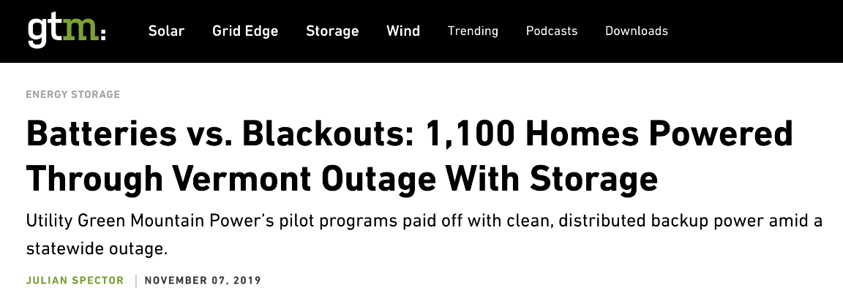
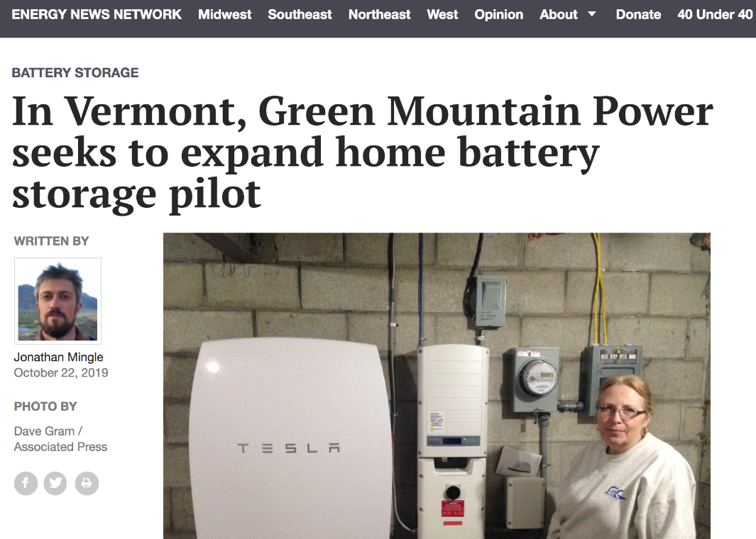
Increasing storage for customers
Climate Resiliency
More than 1,100 customers got backup power during Halloween Storm from Powerwalls (GMP pilots incl. BYOD)
  Batteries provided 10,500 hours of backup
  Average backup was nine hours, longest was 82 hours
  With storms increasing, more outages will occur even with hardening

Slide 19
Questions, feedback??
Climate Resiliency
GMP will be presenting our plan to our regulators in early January
Will be doing outreach between now and then as we continue to build the plan

